Slide 1

Life Member Affinity Group (LMAG) http://www.ieee.hr/ieeesection/lm
About our activities and future plans
Srebrenka Ursic, LMAG Chair

Slide 2
Activities and Future Plans
For all below mentioned activities we are organising presentations, discussions and special events. Cooperation with other Chapters and Affinity Groups is fostered. Main topics:
Digital Age - How to reduce the gap between generations ?
Valuable Accomplishments - What has been achieved in Croatia ?
Croatian Terminology - To encourage to work on and to use it
Plan:
To complete respective papers with the hints “how to do it” till the end of this year.

Slide 3
1. Digital Age
How to reduce the gap between generations ?
Baby Boomers (1946. – 1964.)
Generation X (1965. – 1984.)
Millennials / Generation Y (1985. – 2010.)

Slide 4

Digital Age
Motto: Young people is our future. We must help them to succeed both in their life and profession.
Activity highlight: Event organised together with Young Professionals AG: winners of 2016. IEEE "Mind the Gap" contest Ms Meri Tukač and Zlatko Ofak presented their work "Escape the Gap!". Fruitfull discussion followed.
Plan: - To organise thematic events especially with very active Young Professionals. - To make short paper with ideas what to do and how to work on that issue.

Slide 5
2. Valuable Accomplishments
What has been achieved in Croatia ?

Slide 6
Valuable Accomplishments
Motto:
It is necessary not to forget Croatian professional history. By recording it we send the message to young people not to avoid the professional challenges.
Activity highlight:
Until now two important achievements were elaborated and published at our web site:
Plan: - To write criteria about the procedure how to elaborate and accept the respective items.
- To make a few new examples.
1957. | Electroencephalograph (EEG) | Biomedicine electronics
1963. | Triangle Transistor | Semiconductor technology and microelectronics

Slide 7
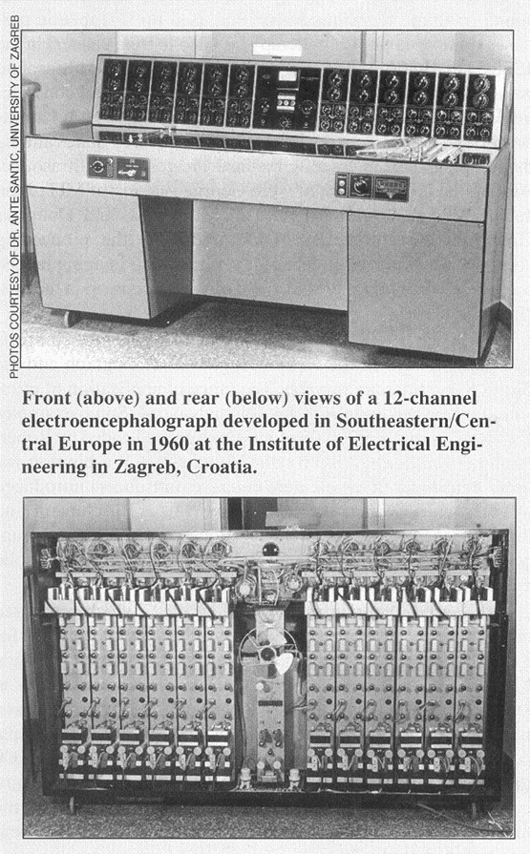
Valuable Accomplishments
An example: ELECTROENCEPHALOGRAPH
In the year of 1957. young engineer Ante Šantić (later on Professor Emeritus at University of Zagreb) developed first electroencephalograph prototype in this part of the world. Short product description is given here: “Front (above) and rear (below) views of a 12-channel electroencephalograph developed in Southeastern/Central Europe in 1960 at the Institute of Electrical Engineering in Zagreb, Croatia”. (source: IEEE Engineering in Medicine and Biology (May/June 2002.): "Golden Accomplisments in Biomedical Engineering")

Slide 8
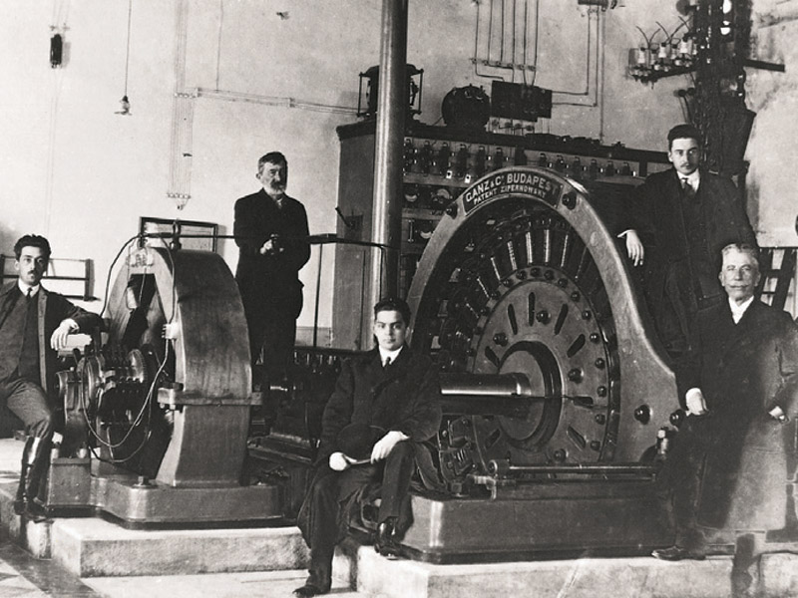
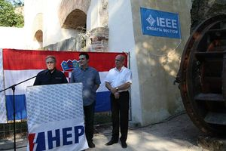
Valuable Accomplishments
IEEE Milestone from Croatia
Šibenik - Krka Electric Power System 1895.
”On 28 August 1895 electricity generated at this location was transmitted to the city of Šibenik, where six power transformers supplied a large number of street lamps. This early system of power generation, transmission and distribution was one of the first complete multiphase alternating current systems in the world and it remained in operation until World War I.”
Plan: We encourage our members to propose more achievements for that prestigous recognition.

Slide 9

3. Croatian Terminology
Language experts work on Croatian terminology and we encourage our professionals to use it !
Above mentioned portal "Bolje je hrvatski !" (eng."Better is Croatian!") made by Institute of Croatian Language and Linguistics is good example how to do it. Everybody can propose the translation of any term from English to Croatian. Language experts analyse it, then they either accept and publish it or give their own translation. We recommend to Croatia Section members to actively use it.
http://bolje.hr/

Slide 10
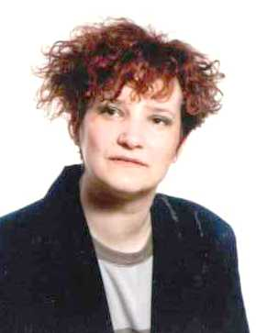
Contacts
Ms Srebrenka Ursic
Croatian LMAG Chair
Authorised Representative at Systemcom Ltd., Zagreb
srebrenka.ursic@systemcom.hr
Aleksandar Szabo
Croatian LMAG Vice Chair
Faculty of Electrical Engineering and Computing, Zagreb
a.szabo@ieee.org

Slide 11
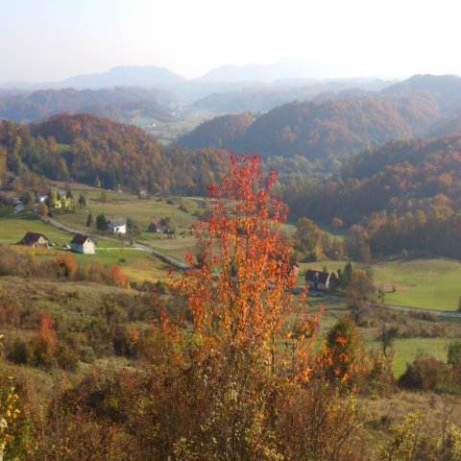
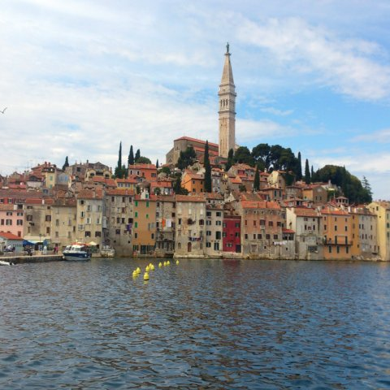
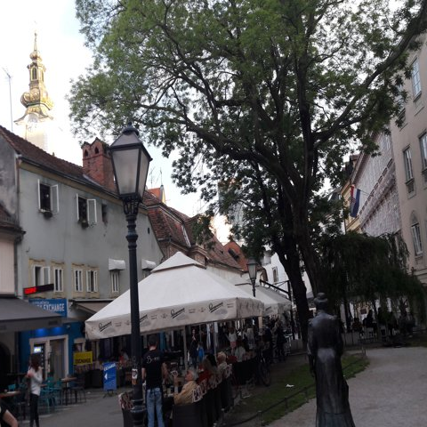
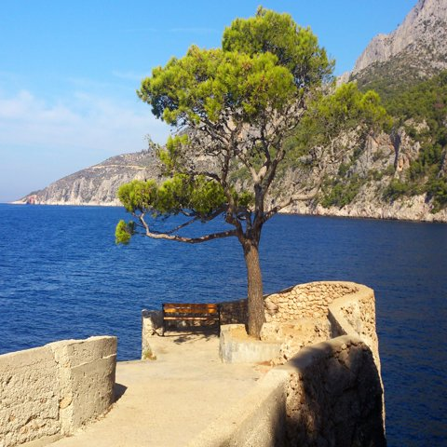
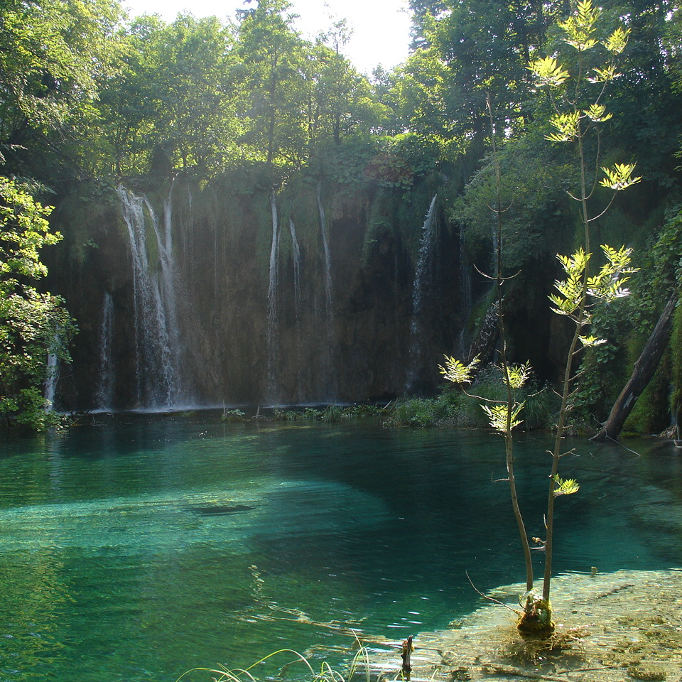
Croatia Section Life Member Affinity Group:
Thank you for your attention !

